Slide 1
Large-Scale Example
Analysis and Specification
Usability Engineering: Process, Products, and Examples
Chapter 6

Slide 2
Introduction
We are going to analyze and derive a specification for a project.
The sample project is to specify and build a user interface for an audio catalog system.
Because we are describing this project, there are no users to interview or observe.
For this presentation, the slides will show the figures from the book.
Notes:
The project is a typical one from our class. We have groups of students (4 to 6) work on it for about 12 weeks of the semester.

Slide 3
Scenario Analysis
Our project system is described by a set of scenarios.
We need to extract the various entities and tasks from the scenarios.
We adopt use case diagrams to help visualize the entities and tasks.

Slide 4
Scenario 7
I am donating a CD to the Humane Society. I want to put a sticky label with the songs on the label. I wish my computerized catalog could do this.
There are two actor roles here: the catalog user and the audio collection.
There is one task: make a label.

Slide 5
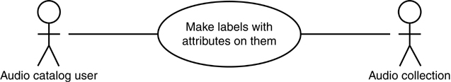
Sample Use Case for Scenario 7
Notes:
Figure 6.8

Slide 6
High-level Diagram
After reviewing the various scenarios, we want to extract the major tasks and form a high-level use case diagram.

Slide 7
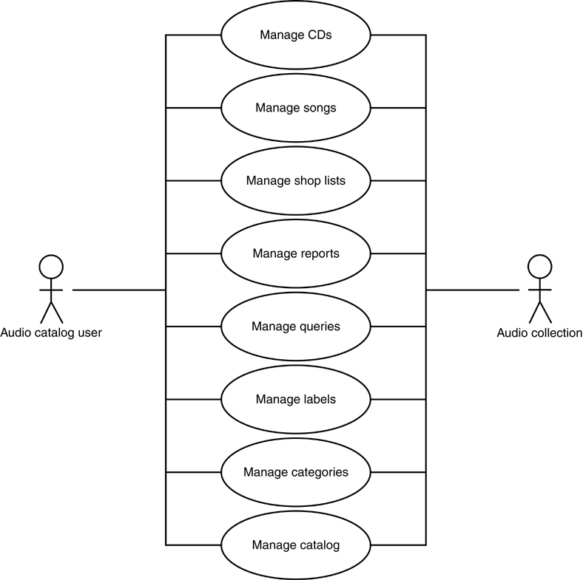
High-level Use Case Diagram

Slide 8
Hierarchical task Analysis
After constructing the use case diagrams, we create the task analysis diagram.
The task analysis diagram is a tree.
The root node is usually a generic task like: Use audio catalog

Slide 9
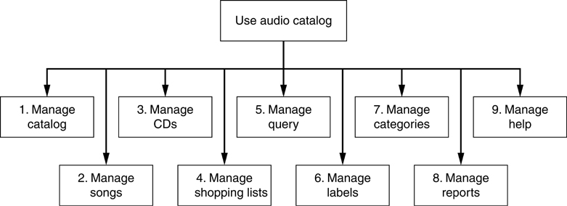
First Two Levels of Hierarchical Task Breakdown
Notes:
This corresponds to the use case diagram on slide 7.
Note that each task starts with a verb. Tasks are actions. The actions should be described in terms familiar to the user.
Numbers are used to help navigate through the various diagrams. The entire task analysis tree is typically too large to fit on a sheet of paper.

Slide 10
Refining the Task Analysis
Each of the tasks needs to be broken down into subtasks.
We will consider Task 3: Manage CDs
What are some of the subtasks for this task?

Slide 11
Hierarchical Breakdown of Task 3: Manage CDs

Slide 12
Further Refining
Many of these tasks also have subtasks.
How many of these tasks should be broken down?
Consider Task 3.1: Add a new CD to catalog

Slide 13
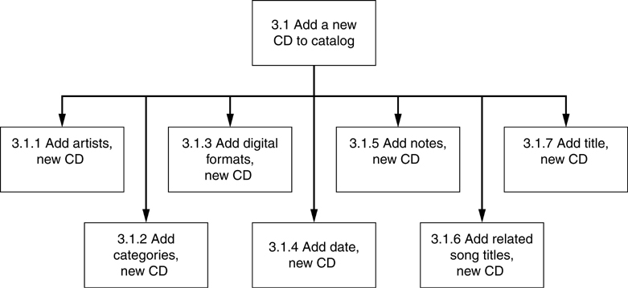
Hierarchical Breakdown of Task 3.1: Add a new CD to catalog

Slide 14
Notes on Task Analysis
Remember the structure of the diagram is a tree.
Use verbs to denote the actions related to the tasks.
Break down tasks until the task is well understood.
Notes:
It is difficult to know when to stop. Usually, tasks go four to six levels.

Slide 15
Task Descriptions
The diagram is helpful to organize the various tasks that the system must support, but it does not contain all the information related to the tasks.
Each task must be supplemented with a text description with additional information.

Slide 16
Task Descriptions
Some useful questions for the text description are:
  What is the goal of the task?
  What noninterface functions does this task require?
  What kinds of inputs are required form the user?
  What kinds of outputs occur?
  What sequencing constraints exist between subtasks?
Notes:
There are additional questions in the textbook.

Slide 17
Conclusions
Information for a project comes in a variety of forms.
Use case diagrams are useful to identify elemental components and tasks.
Tasks and their subtasks can be represented in a tree.

Slide 18
Conclusions
This is a brief excerpt of the detailed elements of analysis and specification for the user interface of the audio catalog project.
In subsequent chapters, we discuss the design of the interaction to support these requirements.

